Slide 1
Restaurant Simulation
Data 604
Christophe Hunt

Slide 2
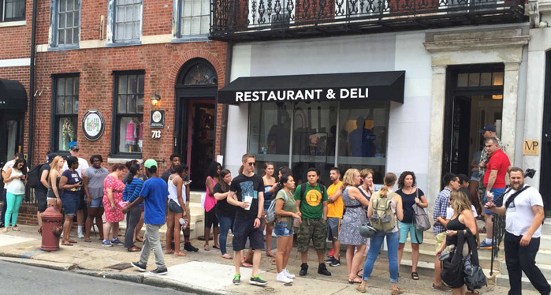
Purpose
Customer dissatisfaction is a major concern within the service industry and can impact financial success.
Customers typically wait for extended periods of time before they are seated and served.
The longer the wait the more dissatisfied the customer becomes which impacts their experience and reduces the likelihood of repeat business, lowers their purchases/tips, all of which can also reduce staff morale.
Hwang, “Restaurant Table Management to Reduce Customer Waiting Times.”
Hwang and Lambert, “The Interaction of Major Resources and Their Influence on Waiting Times in a Multi-Stage Restaurant.”

Slide 3
Background
There are two options for processing customer arrivals
Seat customers on a first come first serve basis, aka “walk-ins”
Seating customers as they arrive has the advantage of optimizing seating space, but the queue can grow quite large since customers can only know if they will be seated once they arrive at the restaurant.
Seat customers only based on reservations made in advance.
The reservation system has the benefit of customers being seated as soon as they arrive but there will be no-shows and last-minute cancellations that leaves empty tables and lost revenue.
Research has shown that in some cases the average mean revenue per person is higher for reservations compared to walk-in guests.
No single perfect system exists but our simulation will consider the performance of a restaurant with a no reservation policy and an intervention of a reservation only policy.
Gregorash, “Restaurant Revenue Management.”

Slide 4
Structure
In the simulation we will make some assumptions about our customer’s behavior.
Customers arriving alone - “Customer_1” will be seated at the bar – “Bar”
Customers arriving in pairs “Customer_2” will be seated at a two-person table - “Table_2”
Customers will be seated here even if room exists at either the “Bar” or a 4 person table
Customers arriving as a party of 4 “Customer_4” will sit at the table for 4 people “Table_4”
Customers will be seated here even if a 4 person row of stools are available at the bar or two 2-person tables are available
It’s likely that staff would combine tables to optimize seating but that complexity goes beyond the scope of our simulation.

Slide 5
Assumptions and Distributions
Using the restaurant modeled in “Case Study for Restaurant Queuing Model”, we’ll assume a restaurant with 15 tables, 10 tables for groups of 4, 5 tables for pairs and 5 seats at the bar.
We will model the weekday dinner rush, for a time of 4-hour time span from 6 pm to 10 pm and then add 100 customers for the extra hour in our model for 500 customers in total each day.
The distribution of arriving groups is 60 groups of 4 (240 people, 35%), 50 groups of 2 (100 people, 30%) and 60 individuals (35%).
Further, people will begin to balk at ~36 people so we’ll extrapolate that to 12 groups of any kind of combination (Lq). A more robust model may accommodate the differences in group sizes and adjust accordingly.
Λ = 500/240 = 2.08 customers/minute
Wq = 36 customers/2.08 cpm = 17.31 minutes
Hwang, “Restaurant Table Management to Reduce Customer Waiting Times.”
Gregorash, “Restaurant Revenue Management.”
Dharmawirya and Adi, “Case Study for Restaurant Queuing Model.”

Slide 6
Assumptions and Distributions
Our dining times will follow the distribution provided in “Restaurant Table Management to Reduce Customer Waiting Times.” which follow a uniform distribution of 40 to 45 minutes (W).
Therefore, the average number of people in the restaurant is
L = 2.08 cpm * 45 minutes = 93.6 customers
utilization rate μ = (2.08 * (1+93.6))/93.6 = 2.10 cpm.
The cost per person for the walk-in model will be a uniform distribution between $42 and $74 whereas the revenue per person will be between $47 and $79 for the reservation guests which follows the restaurant model from “Restaurant Revenue Management” that shows reservation guests will pay more than walk-ins.
Since these per group dollar values include tip, we will presume it translates to a wage of $15 for each staff member.
Hwang, “Restaurant Table Management to Reduce Customer Waiting Times.”
Gregorash, “Restaurant Revenue Management.”
Dharmawirya and Adi, “Case Study for Restaurant Queuing Model.”

Slide 7
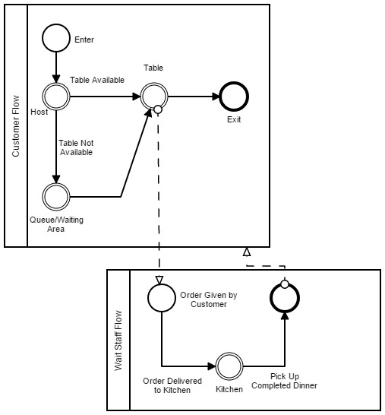
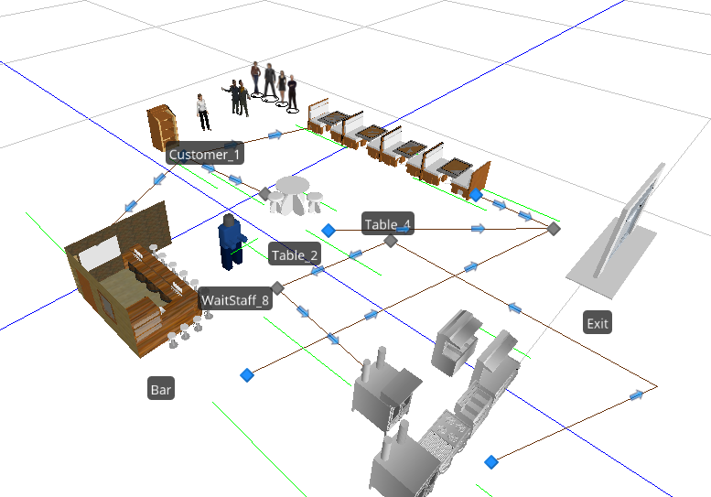
Simulation Visualizations
Simulation 3D Model
Workflow

Slide 8
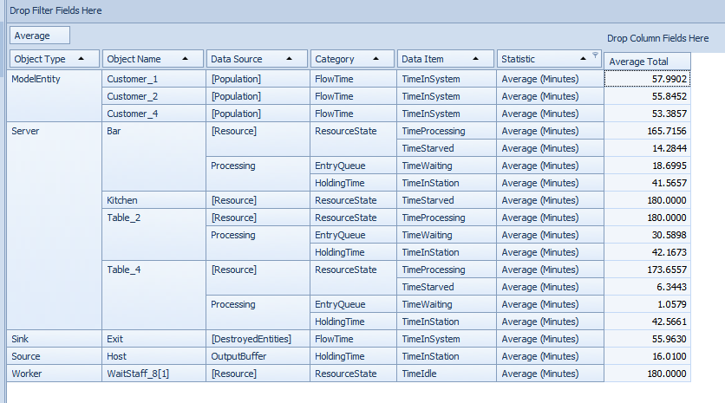
Initial Simulation Results
The average wait time during the three-hour period is 16 minutes and we were hoping to model a 15 minute wait.
In our intervention model, the wait time should at most be 5 minutes.
We wanted to have an entire time spent in the restaurant to be approximately 45 minutes, the average time of 53 to 57 minutes is within an acceptable range.
The major concern is the difference in wait times between the three groups. Our 4-person group waits nearly no time at all, with our bar customers waiting 20 minutes and our group of 2 waiting nearly 30 minutes.
To achieve a more balanced wait time we adjusted the number of tables as follows, 5 4-person tables, 5 2-person tables, and 5 1-person spots at the bar. The restaurant is at full capacity with 35 people.

Slide 9
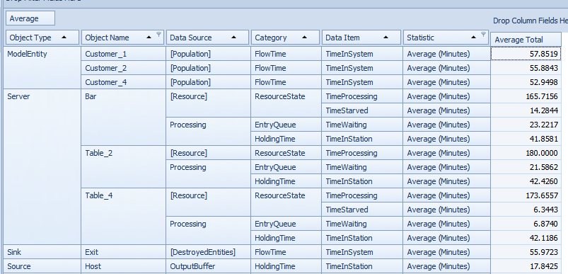
Modified Simulation Results
While our wait times were more balanced our actual customer throughput is considerably under the total we initial considered at 112.
Therefore, we adjusted the table counts up to 6 4-person tables, 7 2-person tables, and 8 1-person spots at the bar.
The restaurant is at full capacity with 46 people, however, we only processed 211 customers for the entire time-period.
Since our primary objective is to understand how wait times, more without a reservation and less with a reservation, we will forgo the validation of the customer counts and continue with this table set up since we see normalized wait times by customer type.
Anecdotally, my experience has been I could sit at the bar immediately or can wait for a table that falls within normal table as seen in the table.

Slide 10
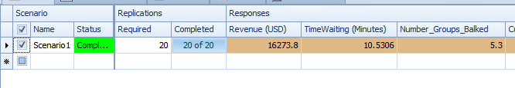
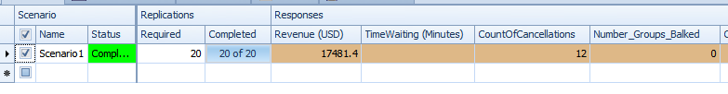
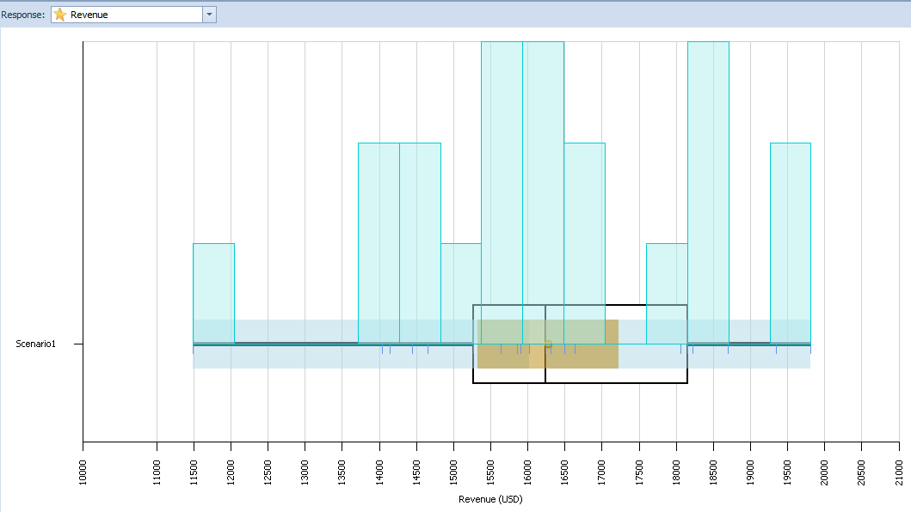
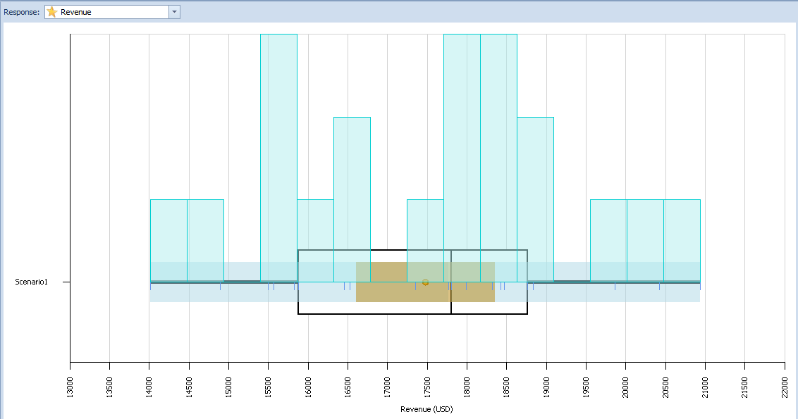
Simulation Results
Status Quo Model
Intervention Model
Status Quo Revenue
Intervention Revenue

Slide 11
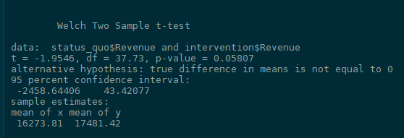
Statistical Comparison
After conducting a t-test on the means of revenues for the status quo and the intervention, we see that the p-value exceeds .05.
Therefore we can conclude that the means are significantly similar, although the p-value is approaching significance.

Slide 12
Conclusion
Surprisingly, the reservation method generated the highest revenue which is our focus of interest. I would have assumed that with the cancellations there would be less revenue even with a higher average per customer.
However, based on the research there are many things to consider first before implementing the strategy. If the reservation cancellation rate is less than a uniform distribution of ~9% to ~12% then this strategy may be more acceptable. Although, the reservation system requires significantly more coordination, such as follow up calls to confirm the reservation, managing tables for lingering guests so reservations stay on track, etc. If the staff support is not there to coordinate a seamless experience for the customer than this strategy may not be appropriate under any circumstances.
If our sole objective is increased revenue, and all else is the same then the recommendation would be the walk-in strategy because it requires less effort than the reservation strategy while achieving similar revenue outcomes.

